Slide 1
HOUSING PREDICTION PROJECT
by
Puneet Jawa

Slide 2
Problem Statement
A US-based housing company named Surprise Housing has decided to enter the Australian market.
The company uses data analytics to purchase houses at a price below their actual values and flip them at a higher price. For the same purpose, the company has collected a data set from the sale of houses in Australia.
We are required to build a model using Machine Learning in order to predict the actual value of the prospective properties and decide whether to invest in them or not.

Slide 3
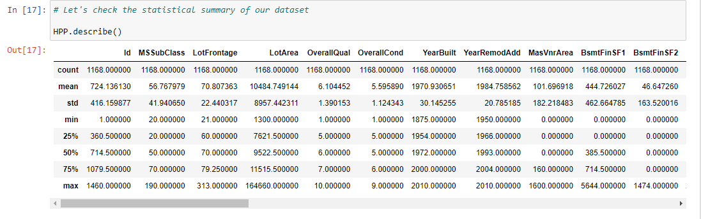
ANALYTICAL PROBLEM FRAMING
In this project we have performed various mathematical and statistical analysis such as we checked description or statistical summary of the data using describe, checked correlation using corr and also visualized it using heatmap. Then we have used Z-Score to plot outliers and remove them.

Slide 4
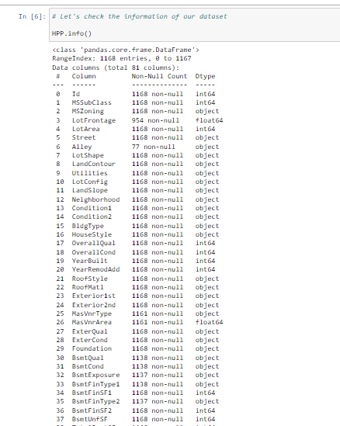
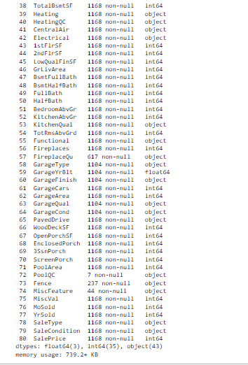
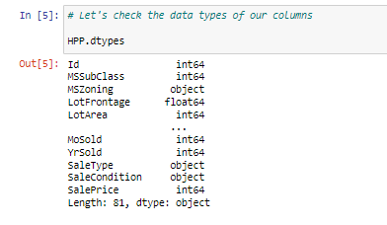
DATA SOURCE AND THEIR FORMATS

Slide 5
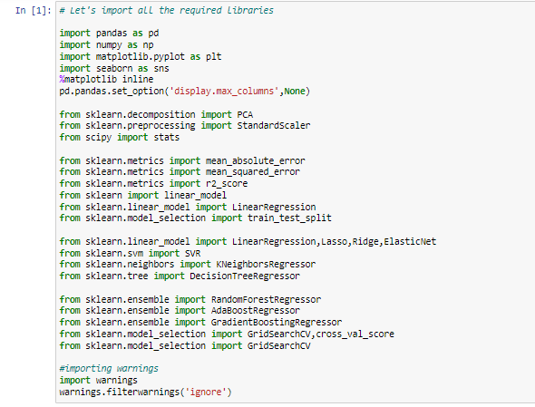
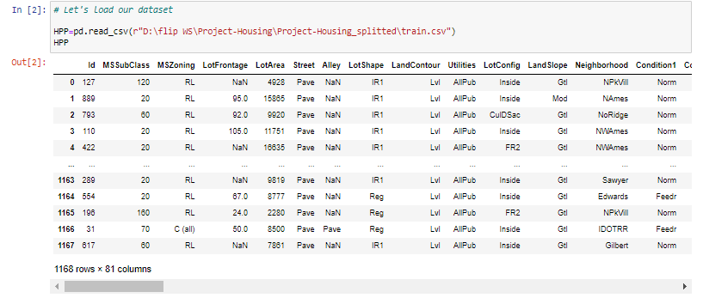
DATA PRE PROCESSING DONE
After loading all the required libraries we loaded the data into our jupyter notebook.

Slide 6
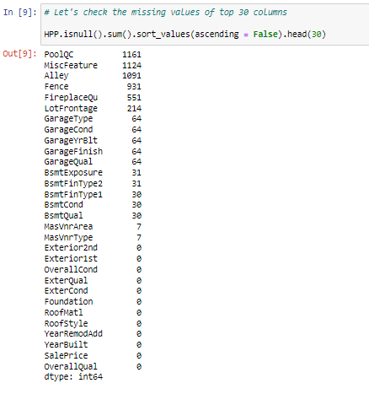
DATA PRE PROCESSING DONE
Feature Engineering has been used for cleaning of the data.
Some unused columns have been deleted and even some columns have been bifurcated which was used in the prediction.
We first done data cleaning. We first looked percentage of values missing in columns then we imputed missing values.
.

Slide 7
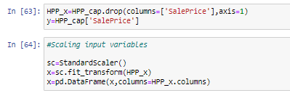
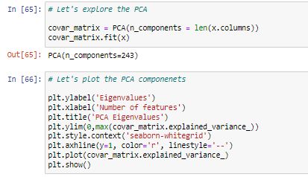
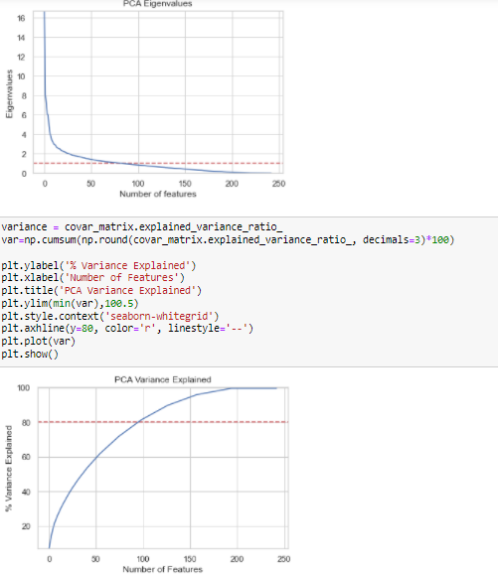
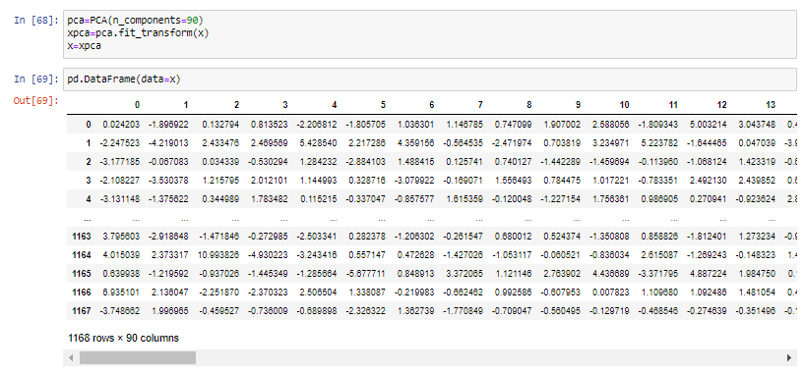
MODEL TRAINING AND PCA

Slide 8
MODEL DEVELOPMENT AND EVALUATION
TESTING OF IDENTIFIED APPROACHES (ALGORITHMS)
The algorithms we used for the training and testing are as follows:-
Linear Regression
Lasso
Ridge
Elastic Net
SVR
KNeighbors Regressor
Decision Tree Regressor
Random Forest Regressor
Ada Boost Regressor
Gradient Boosting Regressor

Slide 9
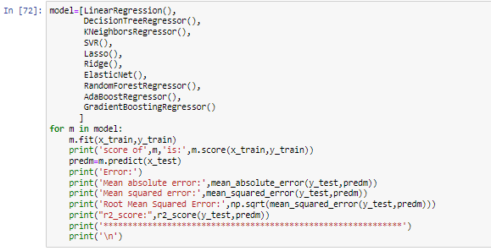
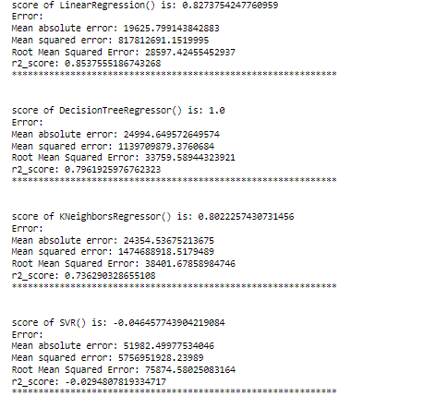
RUN AND EVALUATE SELECTED MODELS

Slide 10
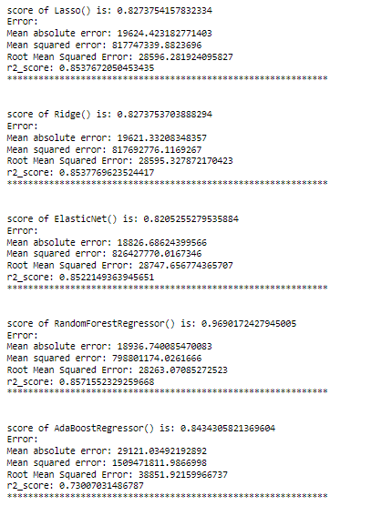
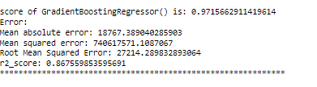
RUN AND EVALUATE SELECTED MODELS

Slide 11
KEY METRICS FOR SUCCESS IN SOLVING PROBLEM UNDER CONSIDERATION
We used the metric Root Mean Squared Error by selecting the Ridge Regressor model which was giving us best(minimum) RMSE score.

Slide 12
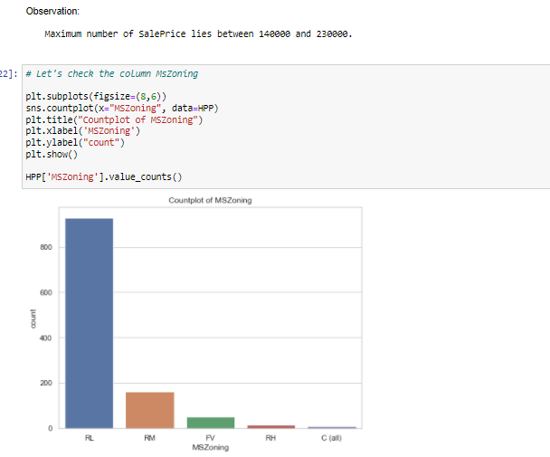
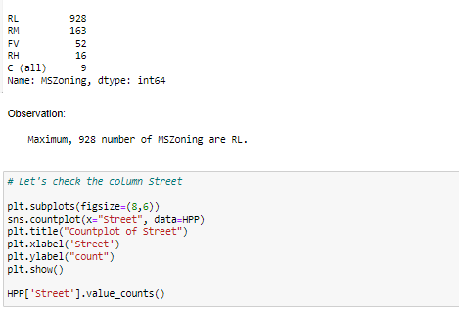
VISUALIZATION:

Slide 13
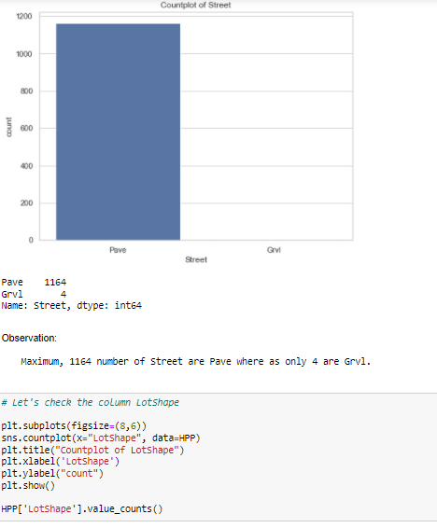
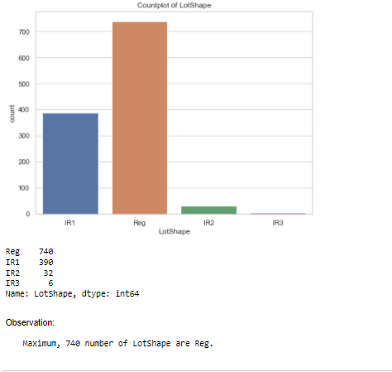
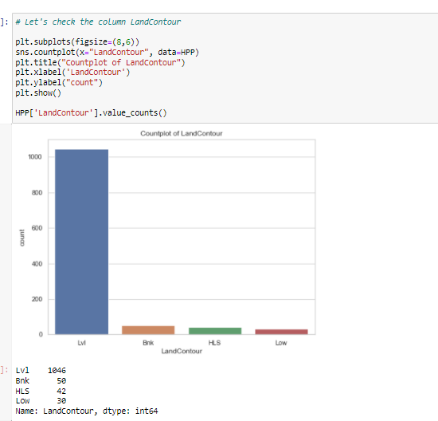
Visualization Continues…..

Slide 14
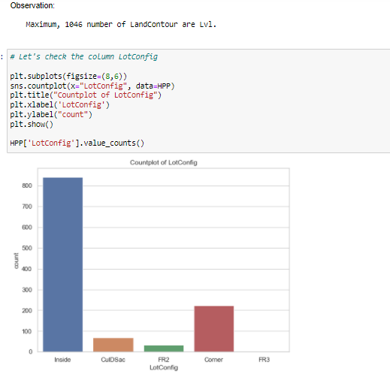
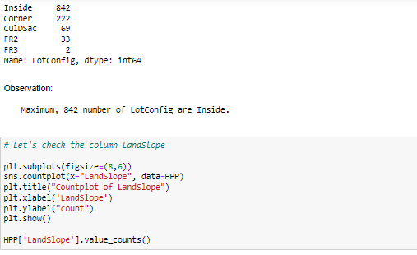
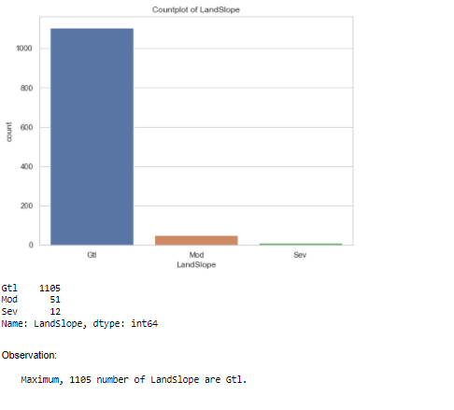
Visualization Continues…..

Slide 15
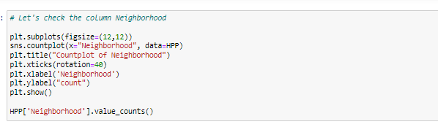
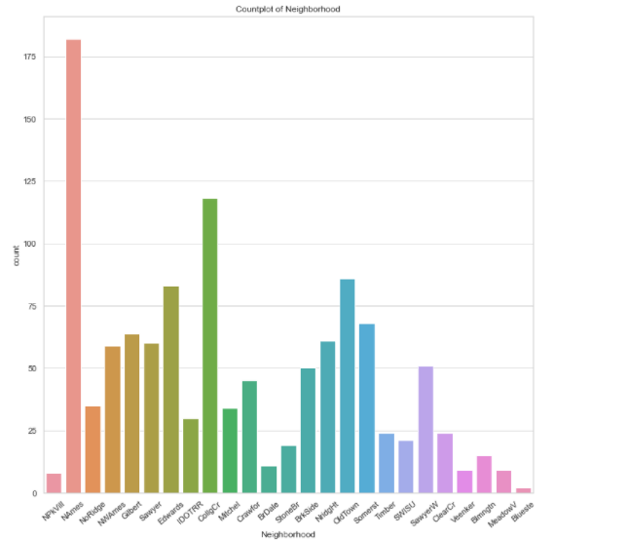
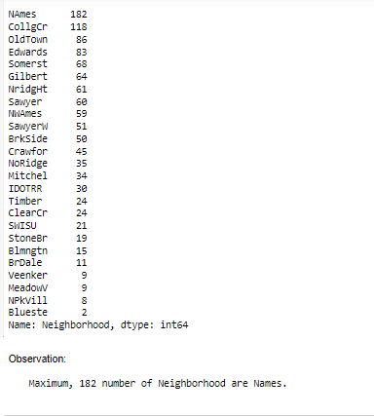
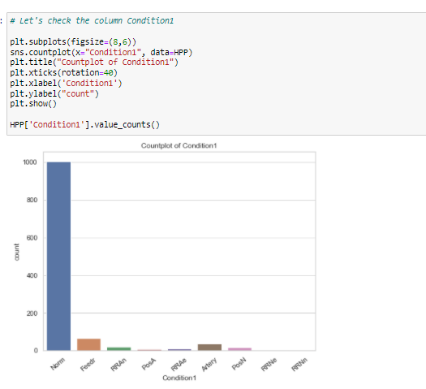
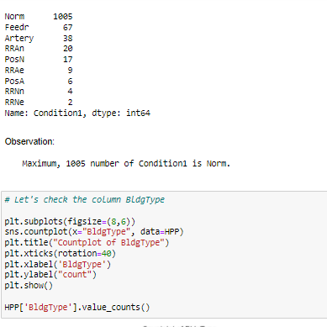
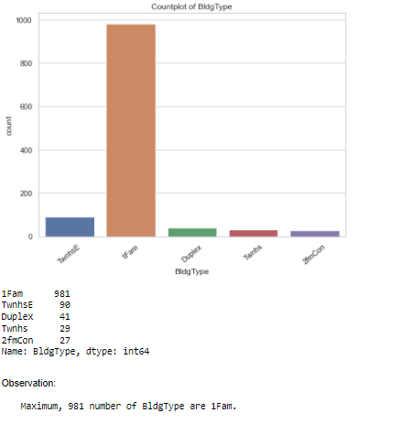
Visualization Continues…..

Slide 16
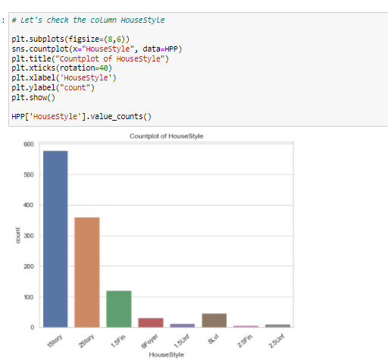
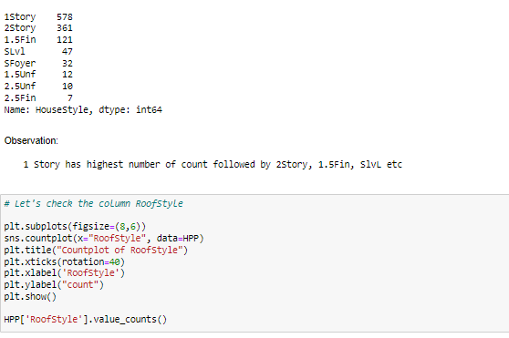
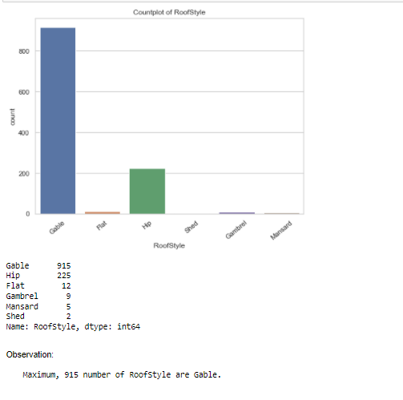
Visualization Continues…..

Slide 17
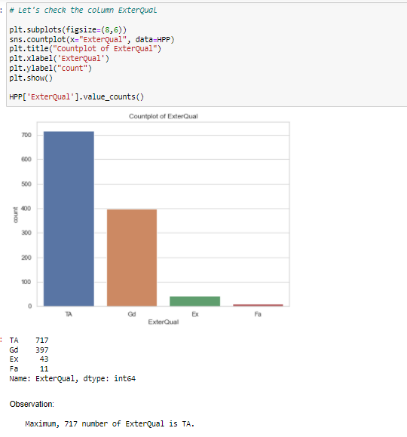
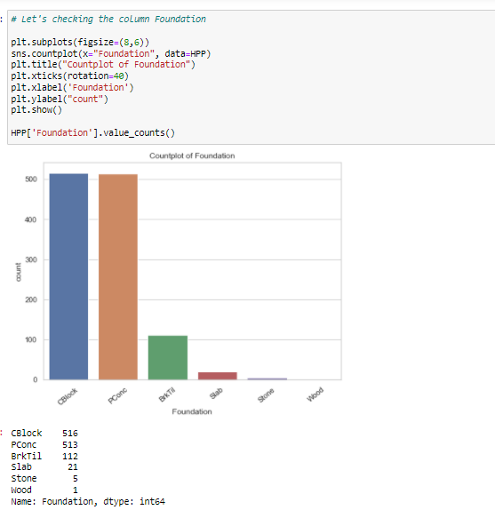
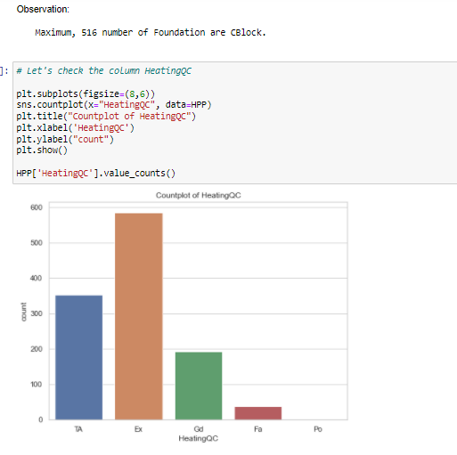
Visualization Continues…..

Slide 18
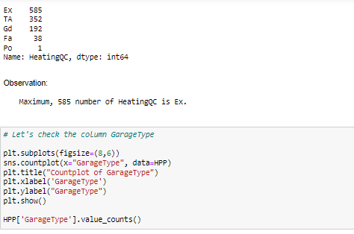
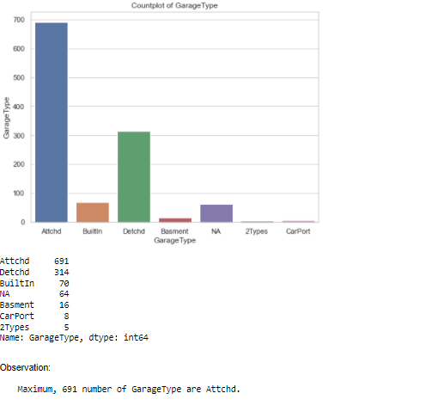
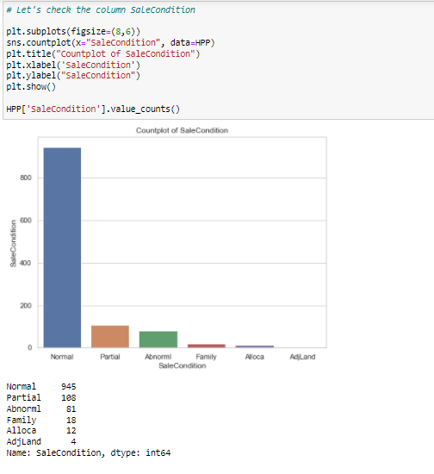
Visualization Continues…..

Slide 19
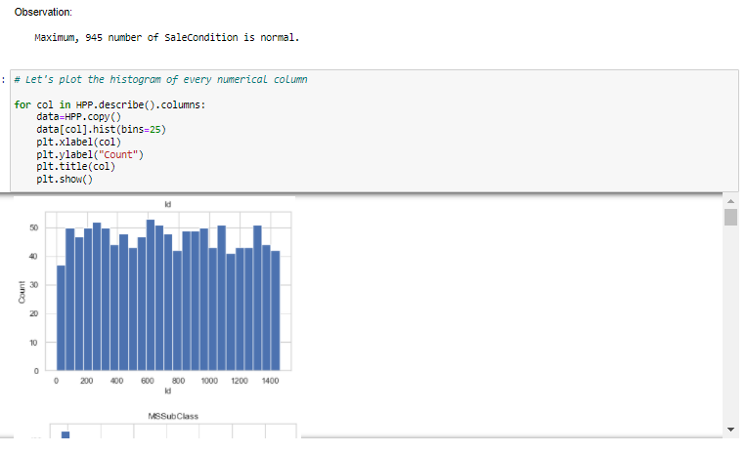
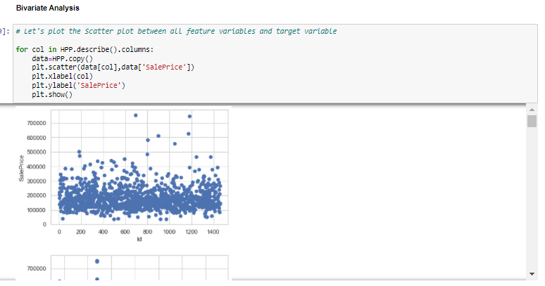
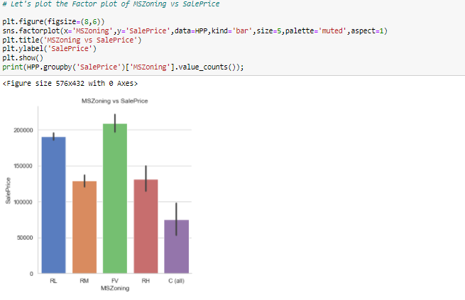
Visualization Continues…..

Slide 20
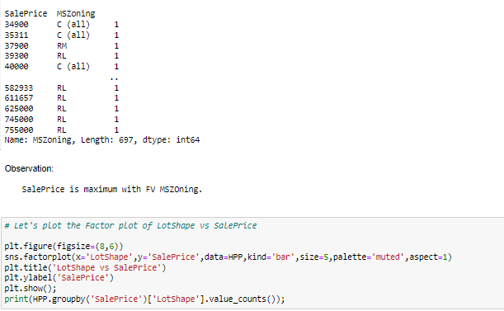
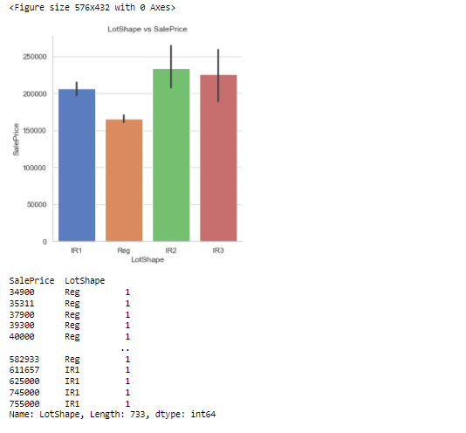
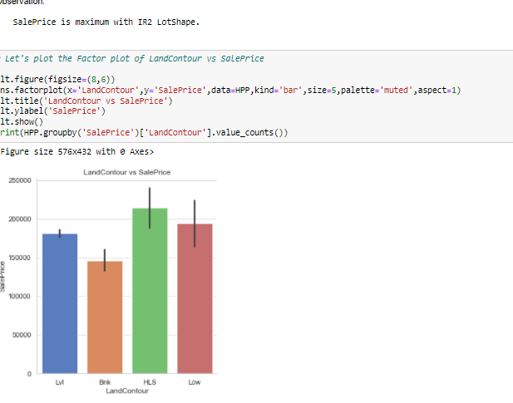
Visualization Continues…..

Slide 21
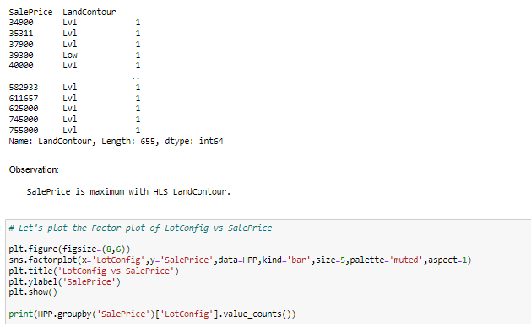
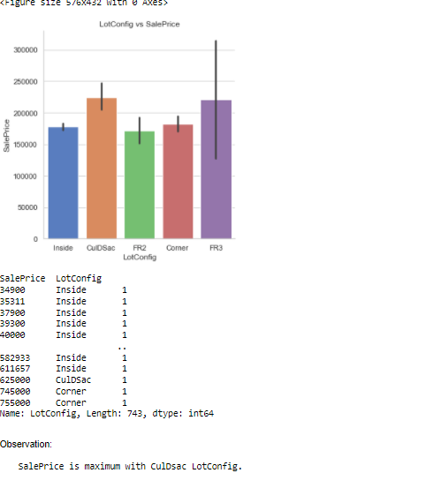
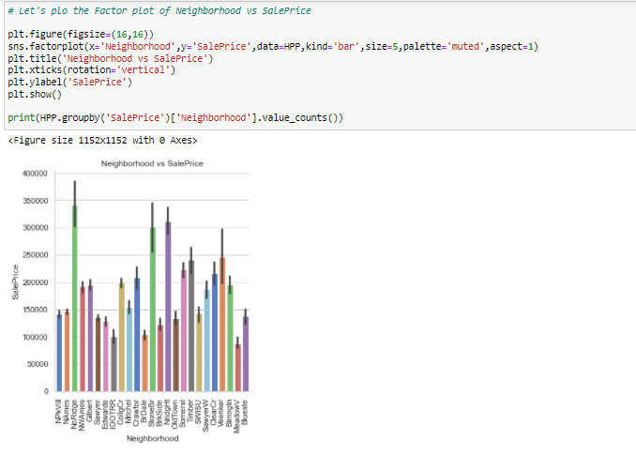
Visualization Continues…..

Slide 22
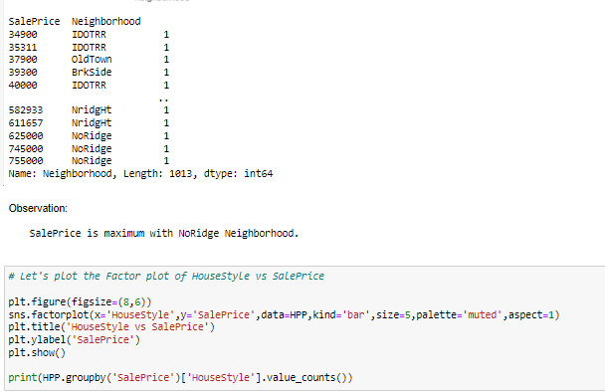
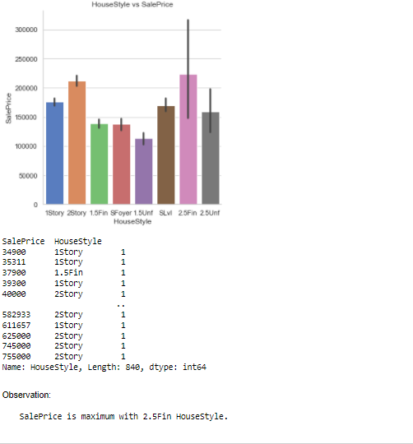
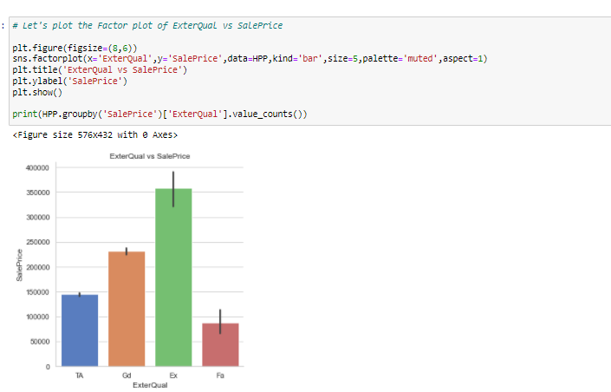
Visualization Continues…..

Slide 23






Visualization Continues…..

Slide 24



Visualization Continues…..

Slide 25


Visualization Continues…..

Slide 26

INTERPRETATION OF THE RESULTS
From the modeling we interpreted that after hyperparameter tuning Ridge Regressor works best with respect to our model with minimum RMSE of 28550

Slide 27
Conclusion
In this project we have tried to show how the house prices vary and what are the factors related to the changing of house prices. The best(minimum) RMSE score was achieved using the best parameters of Ridge Regressor through GridSearchCV though GradientBoosting Regressor model performed well too.
This project has demonstrated the importance of sampling effectively, modelling and predicting data.
Through different powerful tools of visualization we were able to analyse and interpret different hidden insights about the data.
Through data cleaning we were able to remove unnecessary columns and outliers from our dataset due to which our model would have suffered from overfitting or underfitting.

